Slide 1
Finding the best locations for Japanese restaurants in NYC
Capstone Project
The Battle of Neighborhoods (Week 2)

Slide 2
Business Situation
The objective of this Capstone project is to select the best locations in the city of New York to open a new Japanese restaurant.
Using Data Science methodology and instruments such as Data Analysis and Visualization, this project aims to provide solutions to answer the business question: Where in the city of New York, among all the boroughs and neighborhoods should the investor open a Japanese Restaurant?

Slide 3
Data
Data required
List of borough and neighborhoods of New York
Latitude and longitude coordinates of those neighborhoods
Venue data, particularly data related to restaurants
Sources of data
Open source dataset of New York: https://cocl.us/new_york_dataset
Geocoder package for latitude and longitude coordinates
Foursquare API for venue data

Slide 4
Methodology
Collect the data from https://cocl.us/new_york_dataset
Clean and process the data into a dataframe
Use FourSquare API, locate all venues and then filter by Japanese restaurants
Ratings, tips, and likes by users will be counted and added to the dataframe
Sort the data based on rankings
Visualize the data using graphing from Python libraries

Slide 5
Results
There’re 306 different neighborhoods in NYC
Queens has the highest number of Neighborhoods:
Brooklyn and Manhattan both have a high number of Japanese restaurants.
Murray Hill in Manhattan has the highest number of Japanese Restaurants with a total count of 3.

Slide 6
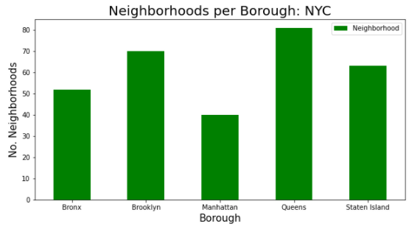
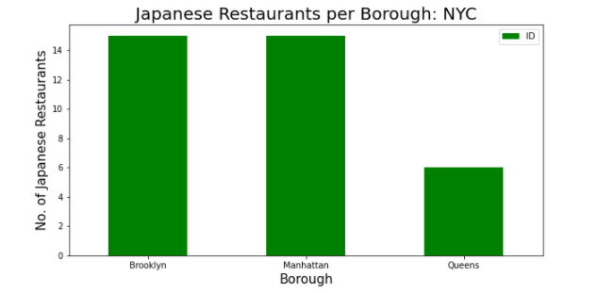
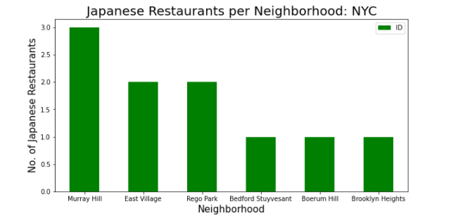
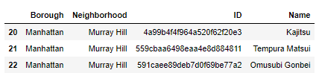

Slide 7
Discussion
Based on the results of our analysis, Manhattan and Brooklyn are the best locations for Japanese cuisine in NYC
Brooklyn is essentially more promising (less overhead investment) to open a new Japanese restaurant.

Slide 8
Conclusion
Answer to business question: Where in the city of New York, should the investor open a Japanese Restaurant?
The findings of this project may be used in real life to better understand the advantages and disadvantages of different New York neighborhoods/boroughs in terms of the competition of opening a new Japanese restaurant.

